Slide 1
AI-CHATBOT (Diabetes Prediction System)

Slide 2
Introduction:
We aim to develop an AI-powered diabetes prediction system that utilizes machine learning algorithms to analyze medical data for early risk assessment and personalized preventive measures. This innovation document outlines the steps for transforming our design concept into a functional system.

Slide 3
DESIGN THINKING RECAP:
Functionality: The chatbot will answer questions, provide guidance, and direct users to relevant resources.
User interface: We'll integrate the chatbot into a website or app with a user-friendly interface.
Natural language processing (NLP): Implement NLP techniques for conversational interactions.
Responses: Plan accurate responses, suggestions, and assistance.
Integration: Decide how the chatbot will be integrated.
Testing and improvement: Continuously refine performance based on user interactions.

Slide 4
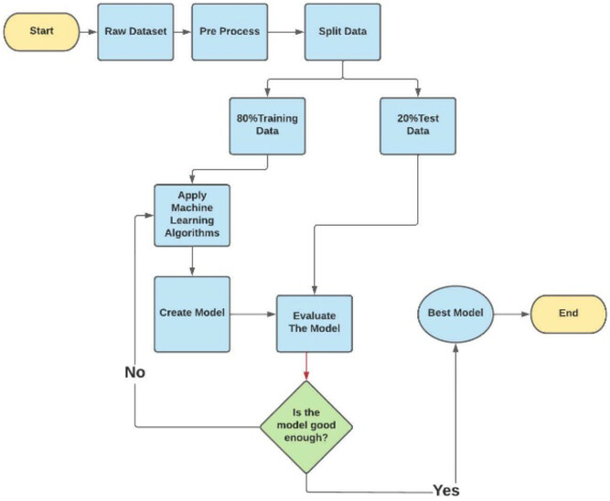
Flowchart:
Diabetes
Prediction
System

Slide 5
TRANSFORMATION STEPS:
Data collection and preprocessing.
Machine learning model development.
Chatbot development.
User testing.
Integration and deployment.
Continuous improvement.
Security and privacy.

Slide 6
A. DATA COLLECTION AND PREPROCESSING:
Gather relevant medical data including patient records, lab results, lifestyle information, and genetic factors.
Anonymize and preprocess the data to remove any identifying information and ensure it's suitable for machine learning.

Slide 7
B. MACHINE LEARNING MODEL DEVELOPMENT:
Choose appropriate machine learning algorithms for prediction, such as logistic regression, decision trees, or deep learning.
Train the model using historical data to predict the likelihood of diabetes development.
Validate and fine-tune the model to ensure accuracy.

Slide 8
C. CHATBOT DEVELOPMENT:
Develop the chatbot interface and integrate it into the designated platform (website, app).
Implement NLP techniques for natural language understanding and generation.
Connect the chatbot to the trained machine learning model for predictive capabilities.

Slide 9
D. USER TESTING:
Launch a beta version of the chatbot for user testing.
Collect user feedback on the chatbot's functionality, usability, and accuracy in predicting diabetes risk.
Address any issues or shortcomings identified during testing.

Slide 10
E. INTEGRATION AND DEPLOYMENT:
Integrate the chatbot into the chosen platform, ensuring a seamless user experience.
Ensure that the system complies with relevant regulations regarding medical data and AI in healthcare.

Slide 11
F. CONTINUOUS IMPROVEMENT:
Monitor the chatbot's performance and user interactions.
Regularly update the machine learning model with new data to improve prediction accuracy.
Implement user feedback to enhance the chatbot's responses and capabilities.

Slide 12
G. SECURITY AND PRIVACY:
Implement robust security measures to protect user data and ensure confidentiality.
Comply with data privacy regulations (e.g., GDPR, HIPAA) to safeguard medical information.

